Slide 1
Long-Term Resource Forecasting for Solar & Wind

Slide 2
Problem statement
GHI forecast for 1-year ahead horizon
Wind Speed forecast for 1-year ahead horizon
GHI forecast for 25-year ahead horizon

Slide 3
Sr. No​ | Today's Agenda
1 | Data Description
2 | Bias Correction Technique
3 | Data Transformation Technique
4 | Modeling approach for Long term forecasting

Slide 4
Actual Data
Solar:
GHI (W/m²):
Resolution: hourly
Duration: 3 year
Natural Features:
Relative Humidity (%)
Temperature (K)
Pressure (Pa)
Wind:
Wind Speed(m/s²) :
Resolution: hourly
Duration: 3 year
Natural Features:
Relative Humidity (%)
Temperature (K)
Pressure (Pa)

Slide 5
Weather Data
Numerical Weather Prediction (NWP) data are the most familiar form of weather model data. NWP computer models process current weather observations to forecast future weather. Output is based on current weather observations, which are assimilated into the model’s framework and used to produce predictions for temperature, precipitation, and hundreds of other meteorological elements from the oceans to the top of the atmosphere.
NCMRWF data:
Temporal Resolution: Hourly data
Variables:
1) Cloud precip
2) Temperature (K)
3) Pressure at mean sea level (HPa)
4) Relative humidity
5) GHI (kWH/m2)
ECMWF data:
Temporal Resolution: 1 day
Variables:
GHI (J/m2)
Temperature (K)
GUST_10m(m/s)
Relative Humidity
Pressure

Slide 6
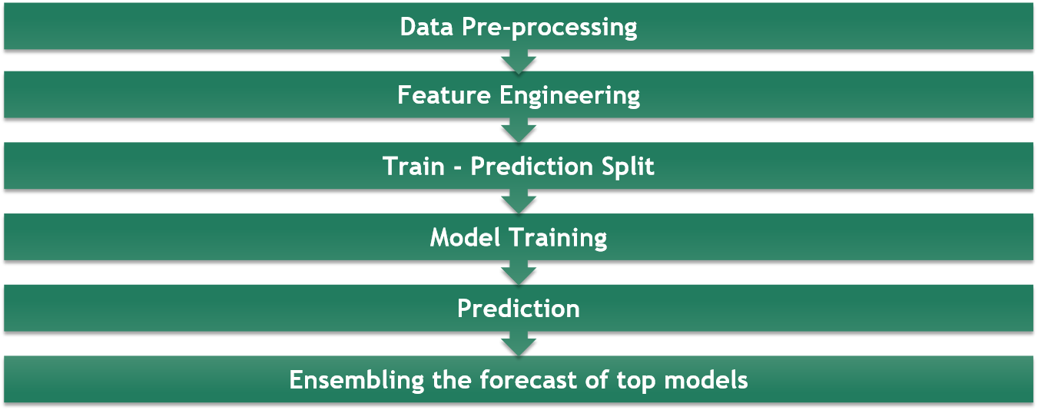
Pipeline

Slide 7
Bias Correction
What is bias correction?
Both Global and Regional Climate models (GCM, RCM) have systematic errors (biases) in their output. For example climate models often have too many rainy days and tend to underestimate rainfall extremes. There can be errors in the timing of the monsoon or the amount of seasonal rainfall, or temperatures can be consistently too high or too low.
Errors in climate models can be caused by a range of factors. Errors or biases are due to limited spatial resolution (large grid sizes), simplified thermodynamic processes and physics or incomplete understanding of the global climate system. Thus, the use of uncorrected outputs in impact models or climate impact assessments can often give unrealistic results.
To correct these type of biases we develop certain algorithm which are termed as Bias correction techniques.
NOTE: Bias correction is also referred to as bias adjustment. The use of the term correction can be misleading because no method is available which corrects for all the biases.

Slide 8
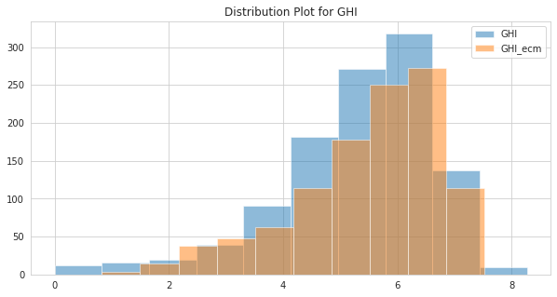
Quantile Mapping
1) The QM methods implement statistical transformations for post-processing of climate modeling outputs.
2) Transforming the distribution functions of the modeled variables into the observed ones using a mathematical function.
3) Relationship between distribution parameter of both the variable is analysed.

Slide 9

Data Transformation Techniques
Normality is an important assumption for many statistical techniques as well as ML algorithm. It is not mandatory but helps in improving the efficiency;
Box-Cox Transformation:
A Box Cox transformation is a transformation of non-normal dependent variables into a normal shape. It does not necessarily transform the data distribution to Normal distribution.
The transformation of Y has the form:
Extended skewness can result into some abnormal forecasted values and thus can affect model accuracy;
2) Logarithmic Transformation:
The log transformation reduces or removes the skewness of our original data. The important caveat here is that the original data has to follow or approximately follow a log-normal distribution.

Slide 10
Experimental Results
Before Data Transformation & Bias Correction
Category | Accuracy
Solar- GHI-Aggregated | 93 %
Wind-Wind Speed Average | 94 %
After Data Transformation
Category | Accuracy
Solar- GHI-Aggregated | 96 %
Wind-Wind Speed Average | 99.6%

Slide 11
Modelling Approach for Long Term Forecasting
Total Models Evaluated: 26
Models Used: Cat Boost Regressor, Histogram-Based Gradient Boosting, Extreme Gradient Boosting, Light Gradient Boosting, Support Vector Regressor, Extra Trees Regressor, Random Forest Regressor, Linear Tree, Artificial Neural Networks, AR, ARIMA, ARMA, etc
Approach 1:
Univariate Forecasting:
1) Target Variable
2) Datetime (Month, day, week)
3) Lag based Features
Approach 2:
Statistical Modeling:
Target Variable
Lag Based Features Used
Approach 3:
Multivariate Modeling:
1) Target Variable
2) Datetime (Month, day, week)
3) Lag based Features
4) Weather Data
Approach 4:
Data Transformation + Multivariate Modeling:
Approach 3 + Data Transformation Techniques on target variable

Slide 12
Results for Long Term Forecasting
Solar
Approach | Average Accuracy
Statistical | 88 %
Univariate | 90 %
Multivariate | 94 %
Multivariate + Data Transformation | 96 %
Wind
Approach | Average Accuracy
Statistical | 87 %
Univariate | 90 %
Multivariate | 95 %
Multivariate + Data Transformation | 97 %

Slide 13
Thank You !

